Slide 1
RAJALAKSHMI INSTITUTE OF TECHNOLOGY
AN EDUCATIONAL INSTITUTION

Slide 2
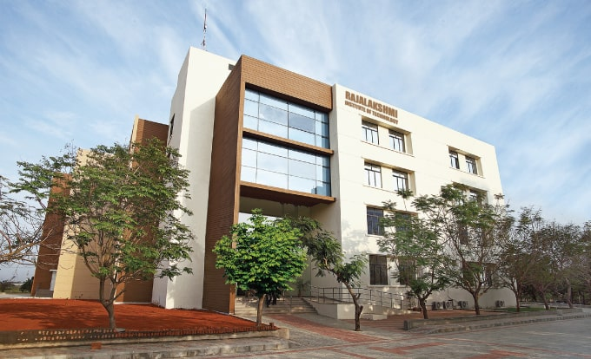
Rajalakshmi Institute of Technology is an engineering college in Chennai, Tamil Nadu, India. RIT is approved by AICTE and affiliated with Anna University.

Slide 3

College life:
College life is known as one of the most memorable years of one’s life. It is entirely different from school life. College life exposes us to new experiences and things that we were not familiar with earlier. For some people, college life means enjoying life to the fullest and partying hard. While for others, it is time to get serious about their career and study thoroughly for a brighter future.

Slide 4
private | enroll | top10perc
yes | 721 | 32
yes | 209 | 87
yes | 104 | 92
yes | 56 | 77
Student–teacher ratio or student–faculty ratio is the number of students who attend a school or university divided by the number of teachers in the institution. For example, a student–teacher ratio of 10:1 indicates that there are 10 students for every one teacher.

Slide 5
GRADUATION:
Graduation is the awarding of a diploma to a student by an educational institution. It may also refer to the ceremony that is associated with it. The date of the graduation ceremony is often called graduation day. The graduation ceremony is also sometimes called: commencement, convocation or invocation.

